Slide 1

Database Management System
Lecture 18
Er. Shiva Kunwar
Lecturer, GU

Slide 2
Lesson 8: Advanced Database Model (4hrs)
Extension of Relational Model
Object-Oriented Model
Distributed Model
NoSQL Systems and XML Database
Notes:
Class discussion on real-world applications of databases.
Quiz on basic database terminology.
Hands-on exercise: Create a simple database using DDL commands.

Slide 3
Extension of Relational Model
Relational model enhance its power and make it more suitable for handling complex data structures.
Object-Relational Model
The Object-Relational Model (ORM) combines the features of the relational and object-oriented models.
It allows for the storage of complex data types such as arrays, structures, and objects, as well as the ability to define user-defined types and functions.
It provides an efficient way to handle complex data and enables the use of object-oriented programming concepts in database applications.
Notes:
Class discussion on real-world applications of databases.
Quiz on basic database terminology.
Hands-on exercise: Create a simple database using DDL commands.

Slide 4
Extension of Relational Model
Extended Relational Model
The Extended Relational Model (ERM) extends the relational model by introducing additional constructs such as derived attributes, multi-valued dependencies, and recursive relationships.
It allows for a more flexible representation of data and provides additional support for data modeling and design.
Semantic Model
The Semantic Model (SM) is a model that extends the relational model by adding semantic information to the database schema.
It enables the representation of knowledge and relationships between entities and allows for more expressive queries that can take into account the meaning of data.
Notes:
Class discussion on real-world applications of databases.
Quiz on basic database terminology.
Hands-on exercise: Create a simple database using DDL commands.

Slide 5
Extension of Relational Model
XML Model:
The XML Model is an extension of the relational model that supports the storage and manipulation of XML data.
It provides an efficient way to store and retrieve complex hierarchical data structures such as documents and web pages.
NoSQL Model
The NoSQL Model is a non-relational model that is designed to handle large volumes of unstructured and semi-structured data.
It provides a flexible and scalable way to store and retrieve data and is commonly used in big data and real-time applications.
Notes:
Class discussion on real-world applications of databases.
Quiz on basic database terminology.
Hands-on exercise: Create a simple database using DDL commands.

Slide 6
Extension of Relational Model
Data Ware Housing
A data warehouse is a large, centralized repository of data that is used for reporting and analysis.
It is typically designed using a relational database management system (RDBMS) and provides a way to store and manage large volumes of data from multiple sources.
The data warehouse uses a schema that is optimized for reporting and analysis and may include denormalized tables and aggregations to improve query performance.
Notes:
Class discussion on real-world applications of databases.
Quiz on basic database terminology.
Hands-on exercise: Create a simple database using DDL commands.

Slide 7
Object-Oriented Model
It adds new features and capabilities that are not present in the traditional relational model.
In the object-oriented model, data is represented as objects, which have properties and methods.
Objects can be organized into classes, which define the properties and behavior of the objects.
Classes can also inherit properties and methods from other classes, allowing for the creation of more complex and sophisticated data structures.
Notes:
Class discussion on real-world applications of databases.
Quiz on basic database terminology.
Hands-on exercise: Create a simple database using DDL commands.

Slide 8
Object-Oriented Model
Let's consider a simple database for a library.
In a traditional relational database, you might have a table for books, with columns for the book title, author, publisher, and publication date.
However, in an object-oriented database, you might represent a book as an object with properties such as title, author, and publication date, and methods such as borrow() and return().
You might also have a class for books, which defines the properties and behavior of all book objects, and subclasses for different types of books.
So, the object-oriented model provides a more flexible and expressive way to represent data than the traditional relational model.
It also supports encapsulation, inheritance, and polymorphism.
Notes:
Class discussion on real-world applications of databases.
Quiz on basic database terminology.
Hands-on exercise: Create a simple database using DDL commands.

Slide 9
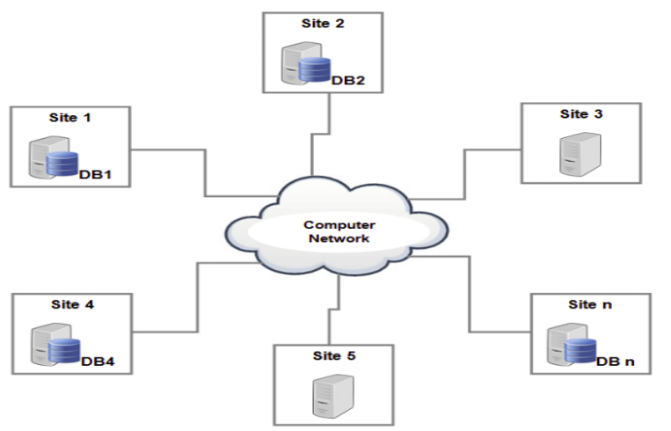
Distributed Model
Distributed database is a collection of multiple, logically related databases which are distributed across the nodes in the system.
In a distributed model, data is distributed across multiple physical locations or nodes, which are connected by a network.
Notes:
Class discussion on real-world applications of databases.
Quiz on basic database terminology.
Hands-on exercise: Create a simple database using DDL commands.

Slide 10
Distributed Model
Example: Online Store → customers in different geographical regions.
Consider an online store with customers in different geographical regions.
You have a database that stores information about your customers, including their names, addresses, and order history.
In a traditional, centralized database system, all the customer data would be stored in a single database located on a server in one location.
This could lead to performance issues if there are a large number of customers or if customers are spread out over a large area.
Additionally, if the server were to fail or go offline, the entire system would be unavailable.
Notes:
Class discussion on real-world applications of databases.
Quiz on basic database terminology.
Hands-on exercise: Create a simple database using DDL commands.

Slide 11
Distributed Model
To address these issues, a distributed database system is implemented which include setting up multiple database servers, each located in a different geographical region.
Each server contains a complete copy of the customer database.
Now, when a customer logs into your online store, their request is directed to the server closest to their location.
The server processes the request using the local copy of the database, eliminating the need for data to be transferred across long distances.
If one server were to fail, customers in that region would still be able to access the system using one of the other servers.
Notes:
Class discussion on real-world applications of databases.
Quiz on basic database terminology.
Hands-on exercise: Create a simple database using DDL commands.

Slide 12
Distributed Model
So, the example provides improved performance, availability, and fault tolerance.
However, it does require additional resources to maintain multiple copies of the database and ensure that they remain in sync.
Advantages
High availability
Scalability
Improved performance
Disadvantages
Increased operational complexity
Increased cost
Notes:
Class discussion on real-world applications of databases.
Quiz on basic database terminology.
Hands-on exercise: Create a simple database using DDL commands.

Slide 13
NoSQL Systems
NoSQL is a type of database management system that is designed to handle large volumes of unstructured or semi-structured data, such as text, images, video, and social media data.
Unlike traditional relational databases, NoSQL databases do not rely on a fixed schema or tabular structure.
Example:
document = {"name": "Ram", "age": 20, "country": "Nepal"}
Notes:
Class discussion on real-world applications of databases.
Quiz on basic database terminology.
Hands-on exercise: Create a simple database using DDL commands.

Slide 14
NoSQL Systems
Document database: These databases store data in documents, typically in a JSON. Each document can contain a different structure, allowing for flexibility in the data model. Examples include MongoDB and Couchbase.
Key-value stores: These databases store data as key-value pairs, with each key corresponding to a value. They are designed for fast retrieval of data and are often used for caching or session management. Example Amazon DynamoDB.
Column family stores: These databases store data in columns, rather than rows, allowing for efficient querying and indexing of data. Examples include Apache Cassandra and HBase.
Graph databases: These databases store data as nodes and edges, allowing for complex relationships and graph analysis. They are often used for social networking, recommendation engines, and fraud detection. Example OrientDB.
Notes:
Class discussion on real-world applications of databases.
Quiz on basic database terminology.
Hands-on exercise: Create a simple database using DDL commands.

Slide 15
XML Database
It abbreviates to Extensible Markup language.
store huge amounts of information in the XML format.
This data can be queried, transformed, exported, and returned to a calling system.
The structure of XML data model is a tree model.
XML model is used to store valuable internal data
Notes:
Class discussion on real-world applications of databases.
Quiz on basic database terminology.
Hands-on exercise: Create a simple database using DDL commands.

Slide 16
Concept of Data Warehouse (Optional Topic)
A data warehouse is a repository (or archive) of information gathered from multiple sources, stored under a unified schema, at a single site.
Once gathered, the data are stored for a long time, permitting access to historical data.
Thus, data warehouses provide the user with a single consolidated interface to data, making decision-support queries easier to write.
Moreover, by accessing information for decision support from a data warehouse, the decision maker ensures that online transaction processing systems are not affected by the decision-support workload.
Notes:
Class discussion on real-world applications of databases.
Quiz on basic database terminology.
Hands-on exercise: Create a simple database using DDL commands.

Slide 17
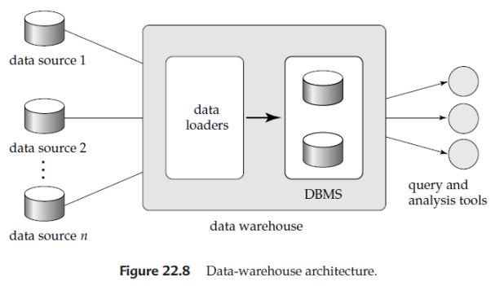
Concept of Data Warehouse
Figure shows the architecture of a typical data warehouse, and illustrates the gathering of data, the storage of data, and the querying and data-analysis support.
Notes:
Class discussion on real-world applications of databases.
Quiz on basic database terminology.
Hands-on exercise: Create a simple database using DDL commands.

Slide 18
Components of Data Warehouse
Among the issues to be addressed in building a warehouse are the following:
When and how to gather data
In a source-driven architecture for gathering data, the data sources transmit new information, either continually (as transaction processing takes place), or periodically (nightly, for example).
In a destination-driven architecture, the data warehouse periodically sends requests for new data to the sources.
Notes:
Class discussion on real-world applications of databases.
Quiz on basic database terminology.
Hands-on exercise: Create a simple database using DDL commands.

Slide 19
Components of Data Warehouse
What schema to use?
Data sources that have been constructed independently are likely to have different schemas.
They may even use different data models.
Part of the task of a warehouse is to perform schema integration and convert data to the integrated schema before they are stored.
As a result, the data stored in the warehouse are not just a copy of the data at the sources.
Instead, they can be thought of as a materialized view of the data at the sources.
Notes:
Class discussion on real-world applications of databases.
Quiz on basic database terminology.
Hands-on exercise: Create a simple database using DDL commands.

Slide 20
Components of Data Warehouse
Data cleansing
The task of correcting and preprocessing data is called data cleansing.
Data sources often deliver data with numerous minor inconsistencies, that can be corrected. For example, names are often misspelled, and addresses may have street/area/city names misspelled, or zip codes entered incorrectly.
These can be corrected to a reasonable extent by consulting a database of street names and zip codes in each city.
Address lists collected from multiple sources may have duplicates that need to be eliminated in a merge–purge operation.
Records for multiple individuals in a house may be grouped so only one mailing is sent to each house; this operation is called householding.
Notes:
Class discussion on real-world applications of databases.
Quiz on basic database terminology.
Hands-on exercise: Create a simple database using DDL commands.

Slide 21
Components of Data Warehouse
How to propagate updates
Updates on relations at the data sources must be propagated to the data warehouse.
If the relations at the data warehouse are the same as those at the data source, the propagation is straightforward.
If they are not, the problem of propagating updates is the view-maintenance problem
Notes:
Class discussion on real-world applications of databases.
Quiz on basic database terminology.
Hands-on exercise: Create a simple database using DDL commands.

Slide 22
Components of Data Warehouse
What data to summarize
The raw data generated by a transaction-processing system may be too large to store online.
However, we can answer many queries by maintaining just summary data obtained by aggregation on a relation, rather than maintaining the entire relation.
For example, instead of storing data about every sale of clothing, we can store total sales of clothing by item name and category.
Notes:
Class discussion on real-world applications of databases.
Quiz on basic database terminology.
Hands-on exercise: Create a simple database using DDL commands.

Slide 23
Data Warehouse - Subject-Oriented
Organized around major subjects, such as customer, product, sales
Focusing on the modeling and analysis of data for decision-makers, not on daily operations or transaction processing
Provide a simple and concise view around subject issues by excluding data that are not useful in the decision support process.
Notes:
Class discussion on real-world applications of databases.
Quiz on basic database terminology.
Hands-on exercise: Create a simple database using DDL commands.

Slide 24
Data Warehouse - Integrated
Constructed by integrating multiple, heterogeneous data sources
relational databases, flat files, and on-line transaction records.
Data cleaning and data integration techniques are applied.
Ensure consistency in naming conventions, encoding structures, attribute measures, etc. among different data sources.
E.g.., Hotel price: currency, tax, breakfast covered, etc.
When data is moved to the warehouse, it is converted.
Notes:
Class discussion on real-world applications of databases.
Quiz on basic database terminology.
Hands-on exercise: Create a simple database using DDL commands.

Slide 25
Data Warehouse - Integrated
The time horizon for the data warehouse is significantly longer than that of operational systems
Operational database: current value data
Data warehouse data: provide information from a historical perspective (e.g., past 5-10 years)
Every key structure in the data warehouse
Contains an element of time, explicitly or implicitly
But the key to operational data may or may not contain “time element
Notes:
Class discussion on real-world applications of databases.
Quiz on basic database terminology.
Hands-on exercise: Create a simple database using DDL commands.

Slide 26
Data Warehouse - Nonvolatile
A physically separate store of data transformed from the operational environment
Operational update of data does not occur in the data warehouse environment
Does not require transaction processing, recovery, and concurrency control mechanisms
Requires only two operations in data accessing:
initial loading of data and access to data
Notes:
Class discussion on real-world applications of databases.
Quiz on basic database terminology.
Hands-on exercise: Create a simple database using DDL commands.

Slide 27
END OF LECTURE 18
SHIVA.KUNWAR@HOTMAIL.COM
+977-9819123654
Google classroom code : drbzdcf

Slide 28
PREVIEW FOR LECTURE 19
DISCUSSION

